Slide 1
AP Macroeconomics – Week 4

Slide 2
6.2 Exchange Rates

Slide 3
Define: the exchange rate, currency appreciation, currency depreciation
Explain: how currencies are valued relative to one another
Calculate: the value of one currency to another

Slide 4
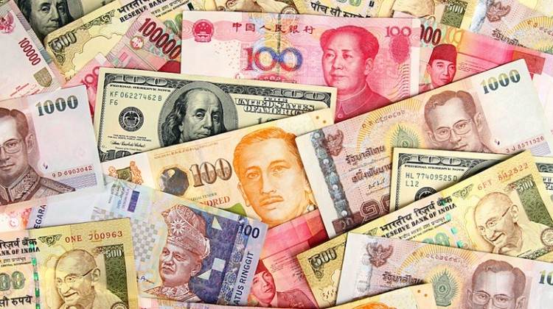
Different Currencies Around the World
Money in Different Countries
We have previously studied the definition of money and the money supply within one country.
However, many countries have completely different currencies with different values, even if they serve the same purposes of money (1. Medium of exchange 2. Store of Value 3. Unit of account)
  Money will have different names, the coins and notes will have different colors and shapes and the denominations will be bigger and smaller.
Summary
There are many currencies around the world with different names and appearances.

Slide 5
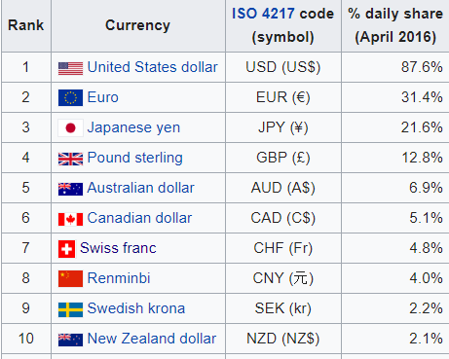
Currency Names and Codes
List of Currency Codes by Country (ISO 4217) (iban.com)
All currencies have an internationally recognized name such as US dollars, Chinese Yuan which usually contain the currency type such as dollars, yen, euros and also the name of the country.
Furthermore, they are also given a unique three letter code and even a three digit numerical code.
  This is more efficient for people who regularly trade currency and also avoids confusion where multiple currencies use similar names. Eg. US Dollars/Canadian dollars/Australian Dollars; Mexican Pesos/Philippines Pesos,

Slide 6
List of Currency Codes by Country (ISO 4217) (iban.com)
Look at the list and choose 5 currency codes to write down.
USD – US Dollars
RMB/CNY – Chinese Renminbi/Chinese Yuan
EUR – Euros
GBP – British Pounds
AUD – Australian Dollars

Slide 7
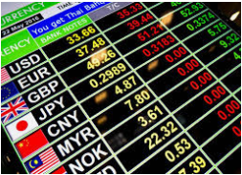
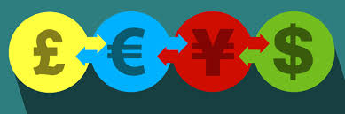
The Exchange Rate
The exchange rate is simply the value of currency A relative to another currency B.
  Eg. 1 USD = 6.5RMB or 1RMB = 0.15USD
The exchange rate is determined by the foreign exchange market which we will cover in the very next chapter.
  In this market, one currency is exchanged for another.

Slide 8
What is a currency’s exchange rate? Give an example.
It is the amount that is needed of one currency to buy another currency.
Eg. 1EUR = 6.99RMB (1 Euro = 6.99 Chinese Renminbi)

Slide 9

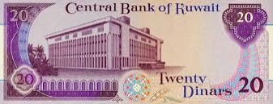
The strongest currencies in the world
These currencies can buy the most USD.
You won’t be able to guess these!
Note: This doesn’t mean the currencies are better or that the people in those currencies are wealthier. They are just nominal values (ie. Numbers that do not necessarily reflect real values.)
1. Kuwaiti Dinar – (1 KWD = 3.29 USD)
2. Bahraini Dinar – (1 BHD = 2.65 USD)
3. Omani Rial – (1 OMR = 2.60 USD)
4. Jordanian Dinar – (1 JOD = 1.41 USD)
5. Pound Stirling – (1 GBP = 1.26 USD)
6. Gibraltar Pound – (1 GIP = 1.23 USD)
7. Cayman Islands Dollar – (1 KYD = 1.20 USD)
8. Euro – (1 EURO = 1.10 USD)
9. Swiss Franc – (1 CHF = 1.01 USD)
10. US Dollar
The Weakest Currencies in the World in 2022 (Feb Updated) | Saudi Scoop

Slide 10

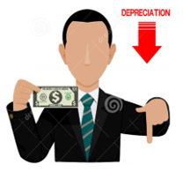
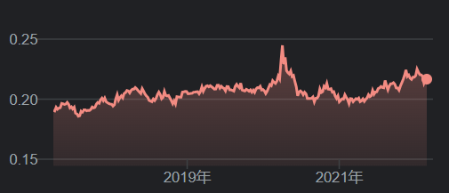
Exchange Rate Movements
The value of a currency can, and often changes.
We can use the following terms to explain these changes.
Appreciate = go up in value eg. RMB can buy more AUD
Depreciate = go down in value eg. RMB can buy less AUD
Exchange Rate Fluctuations = the upward (appreciation) and downward (depreciation) movements that occur over time
Note: When currency A appreciates relative to currency B, currency B therefore depreciates relative to currency A.
Currency Appreciation:
When the currency becomes more valuable in terms of other currencies.
Currency Depreciation
When a currency becomes less valuable in terms of other currencies.
Summary
Appreciation = currency becomes more valuable
Depreciation = currency becomes less valuable

Slide 11
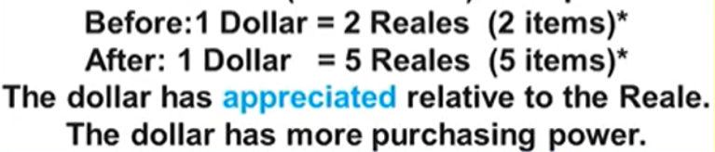
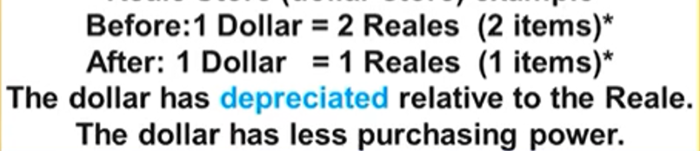
Appreciation and Depreciation Examples
Appreciation Example
Remember: After appreciation, the same amount of a currency can buy more of another currency.
Depreciation Example
Remember: After depreciation, the same amount of a currency can buy less of another currency.

Slide 12


Exchange Rates and Purchasing Power
Summary
Appreciation = ↑Purchasing Power
Depreciation = ↓Purchasing Power
When a currency appreciates or depreciates in value, the purchasing power also increases or decreases.
This will naturally benefit some people who can buy things more cheaply, and disadvantage others who will have to pay more for the same things.
This will lead to changes in behavior that can have significant macroeconomic consequences.
Appreciation = ↑Purchasing Power
Who benefits:
People travelling to other countries
People buying imports
People investing in other countries
People on fixed incomes, living overseas.
Appreciation = ↑Purchasing Power
Who benefits:
People travelling to other countries
People buying imports
People investing in other countries
People on fixed incomes, living overseas.
Depreciation = ↓Purchasing Power
Who benefits:
Exporters whose goods are now cheaper for foreigners
Foreign investors in the country
Depreciation = ↓Purchasing Power
Who benefits:
Exporters whose goods are now cheaper for foreigners
Foreign investors in the country

Slide 13
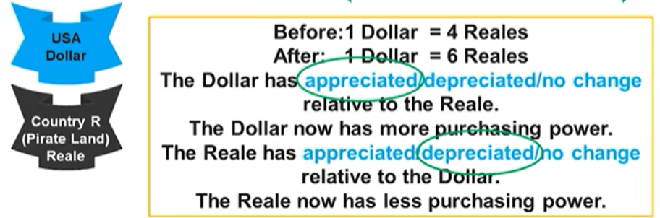
Identify Appreciation/Depreciation and Purchasing Power
Look at the following situation and explain what happens to:
The value of the US dollar (appreciation/depreciation) and its purchasing power.
The value of the Real (appreciation/depreciation) and its purchasing power.

Slide 14
Identify Appreciation/Depreciation and Purchasing Power
Look at the following situation and explain what happens to:
The value of the US dollar (appreciation/depreciation) and its purchasing power.
The value of the Real (appreciation/depreciation) and its purchasing power.

Slide 15
Who are some individuals who would like the Chinese Yuan to appreciate in value?
Chinese citizens who want to travel overseas.
Chinese citizens who want to invest overseas.
Foreigners working in China who want to send money back home.
Who are some individuals who would like the Chinese Yuan to depreciate in value.
Foreigners who want to buy Chinese exports.
Chinese exporters who want to sell more.
Foreigners who want to invest in China to buy stocks/property/bonds.

Slide 16
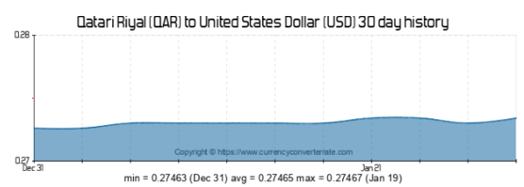
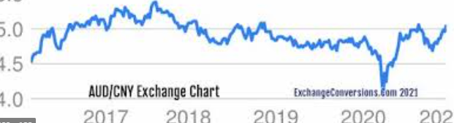
Floating vs Fixed Exchange Rates
Governments can choose to control the exchange rate or allow it to fluctuate. These two exchange rate systems are given these two names.
Note: Floating exchange rates are far more common and therefore our default assumption is that questions will concern floating exchange rates.
  Fixed = the government controls the exchange rate
Floating = the government allows market forces to decide the exchange rate
  Managed float = the government allows market forces to dictate the price but also intervenes when it wishes
  Eg. Italy was accused of manipulating their exchange rate so that local firms had an advantage in exporting
The AUD fluctuates in value compared to the Chinese Currency CNY/RMB.
This is a floating exchange rate system.
Eg. The Qatari currency is set to the USD.
This is a fixed exchange rate system.

Slide 17
What is a fixed exchange rate system?
It is a system where the government wishes to set a currency’s exchange rate to a certain rate and will manage this rate.
What is a floating exchange rate system?
A system where the exchange rate is determined by market forces (ie. Demand and supply) and can therefore can frequently change in value.

Slide 18

Exchange Rate Summary
Appreciation = ↑Purchasing Power
Who benefits:
People travelling to other countries
People buying imports
People investing in other countries
People on fixed incomes, living overseas.
Depreciation = ↓Purchasing Power
Who benefits:
Exporters whose goods are now cheaper for foreigners
Foreign investors in the country
The exchange rate is simply the value of currency A relative to another currency B.
  Eg. 1 USD = 6.5RMB or 1RMB = 0.15USD
Fixed = the government controls the exchange rate
Floating = the government allows market forces to decide the exchange rate
Appreciate = go up in value eg. RMB can buy more AUD
Depreciate = go down in value eg. RMB can buy less AUD

Slide 19
Exchange Rate Maths
Summary
We can use the exchange rate to calculate how much one currency will buy of another.
The exchange rate we are given will typically given in terms of 1 unit of a currency versus another currency.
  1USD = 1EUR
  1RMB = 9.2GBP
Often when we go travelling or any other situation we want to calculate how much of one currency is worth in another.
We can do this with some different methods which achieve the same result:
Multiply or Divide by a number (Fast!)
Eg. 1GBP = 9.2RMB
How much GBP will we get from 60RMB?
In this case we know we have to divide by 9 approximately.
So 60RMB will be approximately 6.5GBP.
Make a Proportion and Solve
Eg. 1GBP = 9.2RMB
How much GBP will we get from 60RMB?
x/60 = 1/9.2
Therefore x = 1/9.2x60 = 6.52
Multiply by ‘1’
Eg. 1GBP = 9.2RMB
How much GBP will we get from 60RMB?
60RMB x 1 = 60RMB
60RMB x (1GBP/9.2RMB) = 60RMB
Cancelling out the units:
60RMB x (1GBP/9.2RMB) = 60/9.2GBP = 6.52GBP
OR:
Use your phone!
Google/baidu or a currency exchange app.

Slide 20
Solve the following:
1RMB = 0.21AUD
How much will an Australian traveler in China get from their Australian money of which they have $325AUD?
Multiply by 1:
325AUD x 1RMB/0.21AUD = 325AUD x 1RMB/0.21AUD = 1,547.62RMB

Slide 21
6.3 Foreign Exchange Market

Slide 22
Learning Objectives
  Define: the foreign exchange market, demand for currency and the supply of currency
  Explain the relationship between the exchange rate and the quantity of currency demanded and supplied
  Define the equilibrium exchange rate.
  Explain how exchange rates adjust to restore equilibrium in the foreign exchange market.
Graphing Skill:
  Draw an accurately labeled graph or visual to represent an economic model or market.

Slide 23
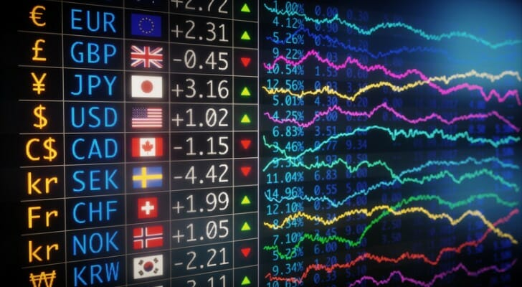
Foreign Exchange Market – ‘Forex Market’
What is the foreign exchange market?
A market is simply a place where buyers and sellers come together whether in a physical space, or increasingly in online spaces.
The foreign exchange rate market is a place where buyers and sellers exchange currency of one country for the currency of another
This determines the equilibrium exchange rate in a flexible exchange market and influences the flow of goods, services and financial capital between countries.
We can call the foreign exchange market the Forex market for short.

Slide 24
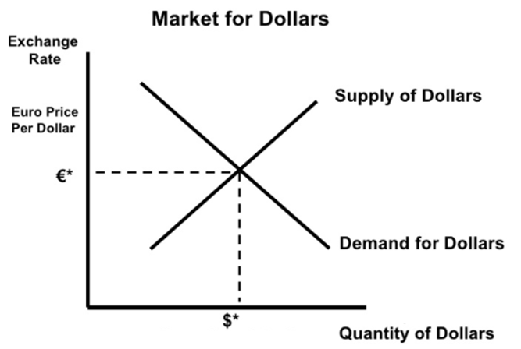
Exchange Rate Graph
The exchange rate graph is a new graph but it is the same as any standard demand and supply graph.
Demand is the demand of people to have money in that currency. Eg. You wish to buy $100 US Dollars for a holiday.
Supply is individuals wanting to give up their currency in exchange for another. Eg. An American wants to give away their US dollars in exchange for Euros.
The price is given in terms of the other currency because when we talk about the price of US dollars we need to talk about how much we give up to buy 1 US dollar.
The Last Major Graph in AP Macro!
Price Axis: We can see that the value of US dollars (USD) is given in terms of Euros (EUR). This is the exchange rate.
  Therefore we can show appreciation and depreciation on this axis.
Appreciation
Depreciation
Quantity Axis: This shows the quantity of Dollars that are being demanded and supplied

Slide 25
If we are looking at the Market for RMB, what could be an example of what could appear on the Y axis?
The exchange rate.
Eg. Euros/RMB
Ie. How many Euros it takes to buy the RMB is the exchange rate.

Slide 26
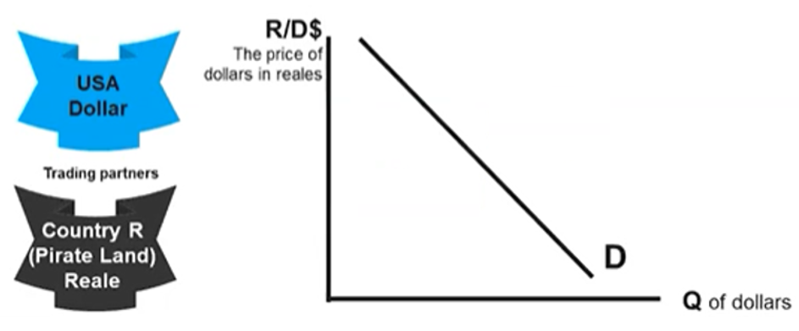
Currency Demand
Summary
Currency demand is for foreigners to buy things in that country.
Downward sloping.
∆Price→movement along curve
The demand for a currency is determined by:
  To buy their exports
  To travel to the other country
  To invest in stocks, government bonds, real estate, etc.
  Etc.
Like all demand curves, there is an inverse relationship between the exchange rate (price) and the quantity demanded of a currency.
  This is because at a lower price, people can afford to buy more.
Therefore change in price (exchange rate) causes a movement along the demand curve.

Slide 27
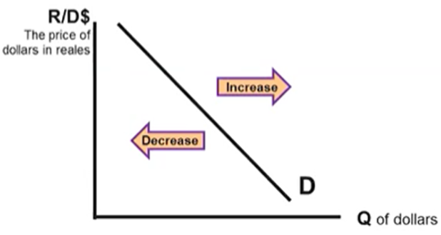
Determinants of currency demand:
Tastes and Preferences
  If the demand for a country’s exports increase, the demand for the currency also increases. This may occur if their products become more popular.
  Investors may also have preferences for investing in property or other investments, therefore increasing or decreasing demand for that currency.
5. Changes in trade policies
An increase in tariffs results in a lower demand for imports from the foreign country. As a result, the demand for foreign currency decreases, and the foreign currency depreciates.
6. Expected Future Exchange Rates
Higher future exchange rates increase demand and lower expected future exchange rates decreases demand. This is what we refer to as speculation because there
2. Income
  When individuals have higher incomes, they will tend to purchase a wider variety of goods including imports.
  Therefore, if income level increases in a country B they will buy more of country A’s exports. Therefore they will demand more of currency A.
3. Interest Rates
If the interest rate increases in country A, then foreign investors will want to put more of their money in country A. Therefore they will demand more of currency A.
4. Price Level (Inflation)
  If a country has issues with inflation then people will be less likely to hold that currency because the value will decrease over time.
  Furthermore, countries with high inflation tend to be less stable overall, discouraging investors and reducing the demand of that currency.

Slide 28



Interest Rates and Capital Flows – The Highest Interest Rate Wins!
Investors like to put their money where they get highest returns, including the loanable funds market (ie. lending money and getting paid back with interest)
If the interest rate in a country increases relative to other countries
  Investors want to put their money in this country where the returns are highest which will increase demand for that currency. (By buying bonds or depositing in banks.)
If the interest rate in a country decreases relative to other countries
  Investors want to move their money out of this country and find a higher interest rate which will decrease demand for that currency.
We call this movement of money, capital flows. Capital inflows = money enters the country. Capital outflows = money leaves the country.
5%
5%
5%
5%
8%
Summary
A country with higher interest rates will attract more capital inflows (investors moving money to that country)
Wow! 8% in Ireland. I will move my money into this country. I need to exchange my currency for more Euros.

Slide 29
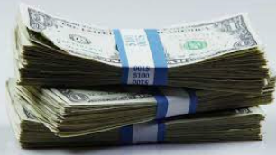

Two Meanings of Capital
Summary
Capital = equipment and machines
Capital = money
Somewhat confusingly, capital can take on slightly different meanings depending on the context, similar to many words in English (eg. Lunch break vs break computer, Wrist watch vs watch TV etc.)
Capital = Equipment and Machines
If you see the terms:
  Capital stock
  Capital formation
  Capital goods
  Investment in capital
This refers to equipment and machines which firms use to help produce goods.
Capital = money
If you see the terms:
  Capital inflows/outflows
  Foreign capital
This refers to money which is lent to businesses and used by businesses.

Slide 30
What are two meanings of the term ‘capital’?
Capital = machines, equipment, infrastructure etc. that boost economic productivity (part of the 4 FOP: land, labor, capital, enterprise)
Capital = money that investors put into a variety of different things. Eg. foreign capital in domestic banks = foreigners putting their savings in local banks

Slide 31
Determinants of Demand
Determinants of Demand
Tastes and Preferences
Income Level
Interest Rates (affects D and S)
Price Level (Inflation) (affects D and S)
Trade Policies (eg. Taxes on imports)
Expectations of Future Exchange Rate
D’
D’

Slide 32

Determinants of Demand
 | Increase | Decrease
Tastes and Preferences | →Buying more G&S from that country→↑D_{currency} | →Buying less G&S from that country→↓D_{currency}
Income Level of other countries | →Buying more G&S from that country as imports→↑D_{currency} | →Buying less G&S from that country as imports→↓D_{currency}
Interest Rates | →investors move more money into that country to earn interest→↑D_{currency} | →investors move less money into that country to earn interest→↓D_{currency}
Price Level (Inflation) | →The value of the money decreases over time (inflation) causing less people to want to hold that currency→↓D_{currency} Note: This also increases the S_{currency} because locals will want to move out of that currency. | →The value of the money increases over time (deflation) causing more people to want to hold that currency→↑D_{currency} Note: This also decreases S_{currency} because less locals want to give up that currency.
Trade Policies (eg. Taxes on goods you export overseas) | →Your goods are more expensive for foreigners because of the tax→↓D_{currency} | →Your goods are less expensive for foreigners because of the lower tax→↑D_{currency}
Expectations of Future Exchange Rate | →investors want to buy that currency now and sell in the future after it goes up→↑D_{currency} | →investors do not want to buy that currency now because they think it will go down in the future→↓D_{currency}

Slide 33
Determinants of Demand
 | Increase | Decrease
Tastes and Preferences | →Buying more G&S from that country→↑D_{currency} | →Buying less G&S from that country→↓D_{currency}
Income Level of other countries | →Buying more G&S from that country as imports→↑D_{currency} | →Buying less G&S from that country as imports→↓D_{currency}
Interest Rates | →investors move more money into that country to earn interest→↑D_{currency} | →investors move less money into that country to earn interest→↓D_{currency}
Price Level (Inflation) | →The value of the money decreases over time (inflation) causing less people to want to hold that currency→↓D_{currency} Note: This also increases the S_{currency} because locals will want to move out of that currency. | →The value of the money increases over time (deflation) causing more people to want to hold that currency→↑D_{currency} Note: This also decreases S_{currency} because less locals want to give up that currency.
Trade Policies (eg. Taxes on goods you export overseas) | →Your goods are more expensive for foreigners because of the tax→↓D_{currency} | →Your goods are less expensive for foreigners because of the lower tax→↑D_{currency}
Expectations of Future Exchange Rate | →investors want to buy that currency now and sell in the future after it goes up→↑D_{currency} | →investors do not want to buy that currency now because they think it will go down in the future→↓D_{currency}

Slide 34
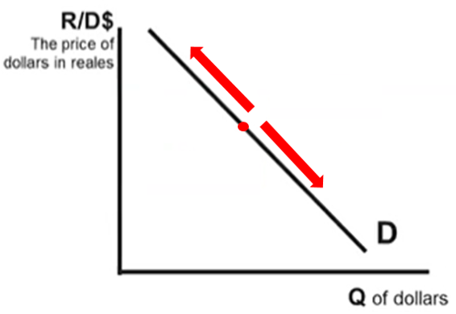
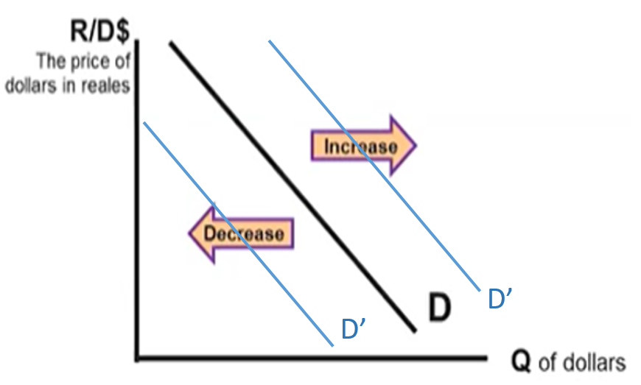
Movement Along the Currency Demand Curve
Shifts of Currency Demand
Causes
Change of price/exchange rate
Determinants of Demand
Tastes and Preferences
Income Level
Interest Rates
Price Level (Inflation)
Trade Policies (eg. Taxes on imports)
Expectations of Future Exchange Rate

Slide 35
What is the result of an increase in the exchange rate in terms of Currency Demand?
The quantity demanded of the currency will decrease. This is a movement ALONG the demand curve.
What is the result of an increase in interest rates in Australia?
An increase in the demand for Australian dollars.
What is the result of an increase in taxes on European exports to the US on the Euro?
The demand for Euros will decrease because Americans will buy less European exports.

Slide 36
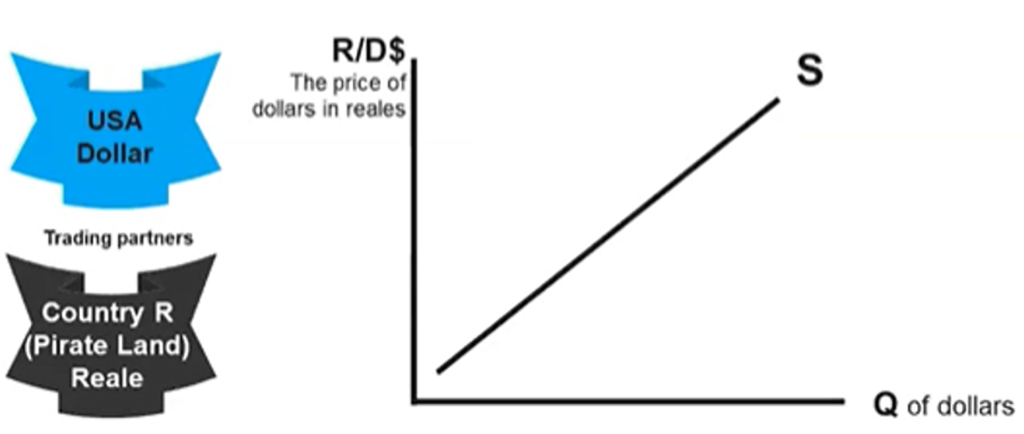

Currency Supply
The supply of a currency in a foreign exchange market arises from the desire for individuals to transact in other countries so they must ‘give up’ their money in exchange for foreign money.
Like all supply curves, there is an positive relationship between the exchange rate (price) and the quantity demanded of a currency.
  This is because at a higher price, suppliers of currency will receive more which gives them a stronger incentive to supply more.
Therefore change of price (exchange rate) will cause a movement along the same supply curve.
Summary
Currency supply is for people who want to buy things in another country.
Upward sloping.
∆Price→movement along curve

Slide 37
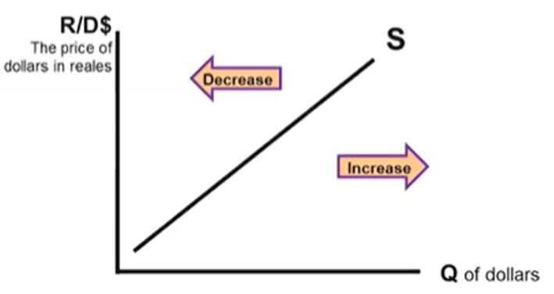
Determinants of Currency Supply
Determinants of Demand AND Supply
Tastes and Preferences
Income Level
Interest Rates
Price Level (Inflation)
Trade Policies (eg. Taxes on imports)
Expectations of Future Exchange Rate
Instead of creating a separate list of determinants for supply we can think of them as the reverse of the determinants of supply
This is because the: Demand for currency A = Supply for currency B.
  Every time someone wants to buy a currency, they have to use another currency to buy it.
Therefore the determinants of currency supply for currency A are the same as the determinants of currency demand for currency B, but reversed.
  Eg. The popularity of exports from country A →↑Demand_{currencyA}, ↑Supply_{currencyB}
  ↓Interest Rates_{CountryA} →↓Demand_{currencyA}, ↓Supply_{currencyB}
Summary
The same determinants of demand of currency apply to supply of currency.
Why? Demand for currency A = Supply of currency B.

Slide 38
If there are only two countries, Country A and Country B, and Country A has an increase in Demand for its currency, what happens to Country B’s currency?
Increase Demand for country A’s currency = Increase Supply of country B’s currency.
To buy more of currency A, people have to give up/supply currency B.

Slide 39
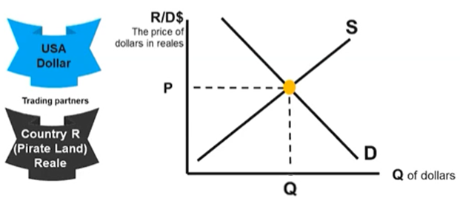
Forex Market Equilibrium
In the foreign exchange market, equilibrium is achieved when the exchange rate is such that the quantity is demanded and supplied of the currency are equal.
Equilibrium point
Equilibrium price
Equilibrium Quantity

Slide 40
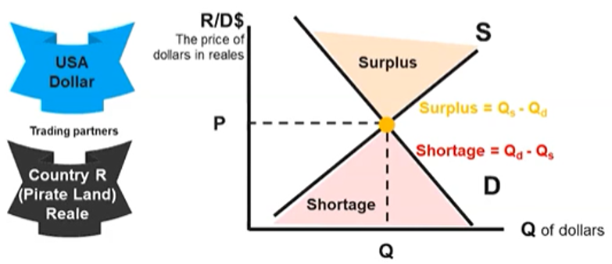
Disequilibrium
How will equilibrium be restored?
Surplus – suppliers will lower their prices to restore equilibrium
Shortage – suppliers will increase their prices to restore equilibrium.
Just like in any market, a price that is too high or low can lead to surpluses and shortages in the foreign exchange market.
A surplus or shortage will automatically be corrected when sellers adjust their prices which drives exchange rates toward equilibrium.
Q_{D}
Q_{S}

Slide 41
If the price is above the equilibrium exchange rate, are we in a situation of surplus or shortage?
Surplus, because at that price more people will be more willing to supply than demand the currency.
Therefore Q_{D} < Q_{S}

Slide 42
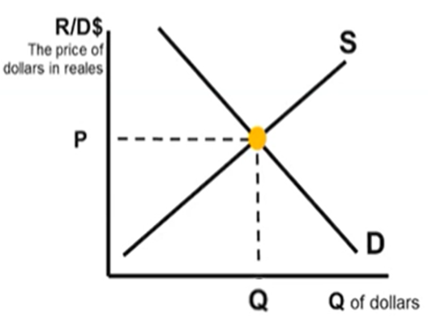
Change in Equilibrium
Just as in our study of any other market, changes in Demand and Supply will cause a change in the equilibrium point.
This is the nature of floating exchange rate systems.
The effect on the equilibrium price and quantity for each of these movements is:
↑Demand→↑Price↑Quantity
↓Demand→↓Price↓Quantity
↑Supply→↓Price↑Quantity
↓Supply→↑Price↓Quantity
Similar to study of markets previously, ∆Demand,∆Supply at the same time will lead to either price or quantity being indeterminate.

Slide 43
What will happen to the US Dollar?
1. Europeans travel more to the US
↑ Demand USD$ more tourism, Appreciate
2. A severe recession in Europe
↓ Demand USD$ less demand for US exports, Depreciate
3. Increase in price level in the US
Demand USD$↓ people don’t want to buy USD, Depreciate
4. Relatively higher interest rate in the US.
↑Demand USD$ investors put their money in the US Banks, Appreciate

Slide 44
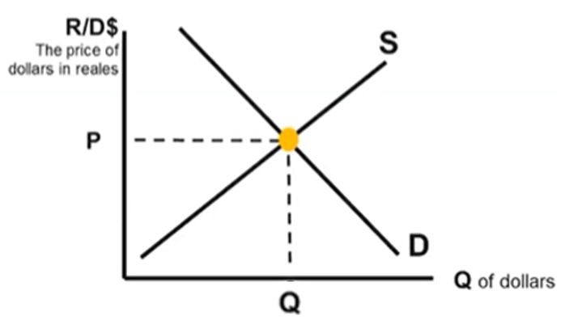


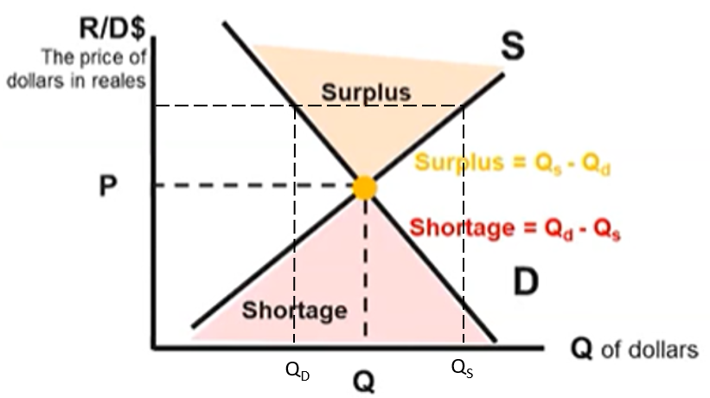
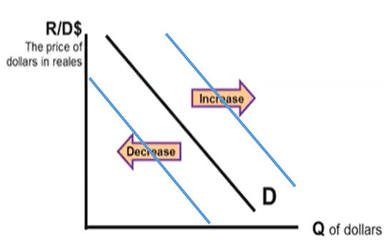
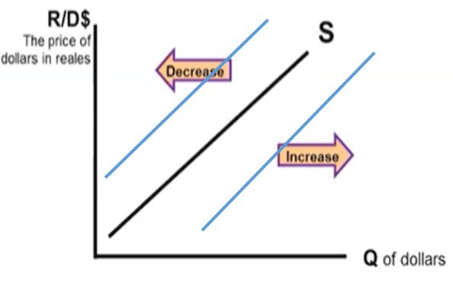
Foreign Exchange Market Summary
The Foreign Exchange Market (Forex market) is where currencies are exchanged and determines the exchange rate/price of currency.
Fixed Exchange rate = exchange rate is constant
Floating exchange rate = moves up and down via market forces
Appreciation
Change in Equilibrium: ↑Demand→↑Price↑Quantity
↓Demand→↓Price↓Quantity
↑Supply→↓Price↑Quantity
↓Supply→↑Price↓Quantity
∆Demand & ∆Supply = either Price or Quantity indeterminate
Depreciation = ↓Purchasing Power → ↓Imports ↑Exports
→Benefits for foreigners buying your currency
Appreciation = ↑Purchasing Power →↑Imports ↓Exports
→Benefits for those buying foreign currencies
Depreciation
Determinants of Demand AND Supply
Tastes and Preferences
Income Level
Interest Rates(affects D and S)
Price Level (Inflation) (affects D and S)
Trade Policies (eg. Taxes on imports)
Expectations of Future Exchange Rate
Surplus and shortage occurs when the price is too high or low.

Slide 45
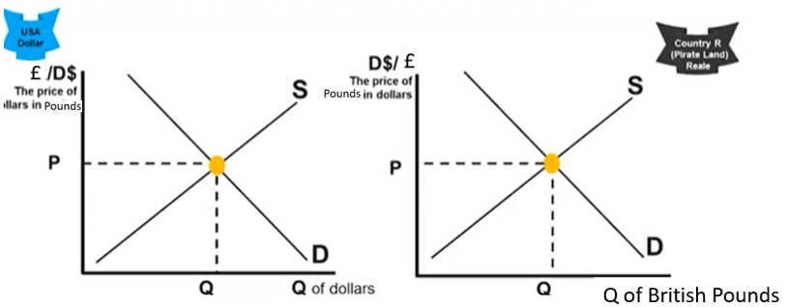
Example – Pounds and US dollars
↑Demand for pounds (↑Supply of dollars)
Examples:
  Governments, households and firms want to buy goods and services made in the UK
  US citizens want to visit the UK as tourists or when they travel to study there
  US citizens want to buy British financial assets such as stocks and bonds
  American firms want to invest in the UK
  Anticipations and speculations that the dollar value will decline relative to the pound
↑ Supply of Pounds (↑Demand for dollars)
Examples:
  Governments, households and firms in Britain want to import goods and services made in the US
  British citizens want to visit the US as tourists or to study there
  British citizens want to buy US financial assets such as stocks and bonds
  British firms want to invest in the US
  Anticipations and speculations that the dollar value will rise relative to the pound

Slide 46
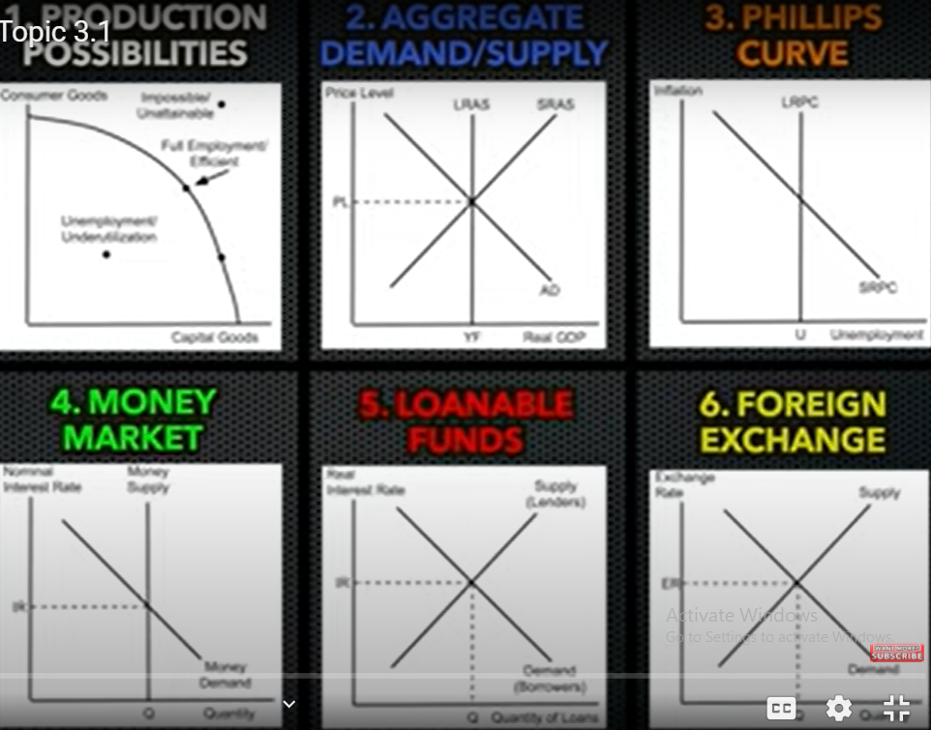
We have now covered the last graph for AP Macro!
Here is a list of the 6 most key graphs that we have covered.

Slide 47
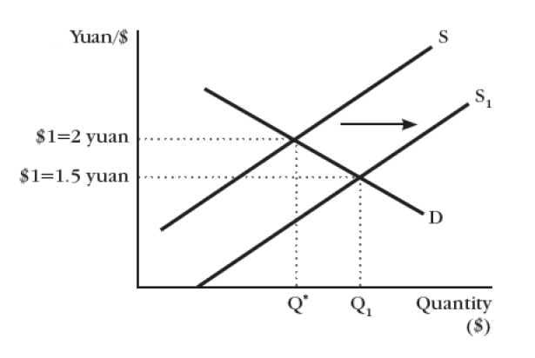
Exchange Rate Review Questions
6. Assume that 1 US dollar currently buys 6.9 Chinese yuan and that the yuan is allowed to float against the US dollar. Show graphically the impact of each of the following on the exchange rate:
a) The US is facing a faster economic growth.
Americans have more money to spend on imports from abroad and supply USD.

Slide 48
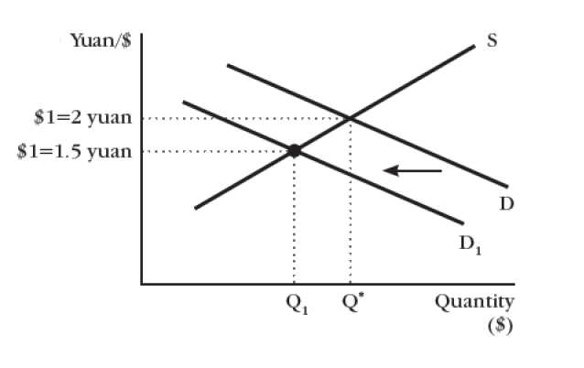
b) The interest rate in the US is expected to decrease.
Investors will invest less in the US because they won’t receive as much of a return in interest.

Slide 49
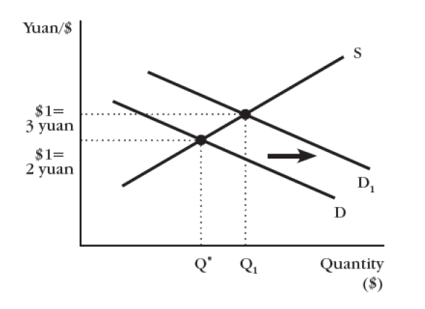
d) China is booming.
More Chinese are likely to go on holidays, send Children to US universities, buy US goods etc.

Slide 50
e) There is high inflation in the US.
People are less likely to want USD, because inflation makes money worth less over time.

Slide 51
Two Currency Questions
We have looked at movements in a single foreign currency market, but often questions will involve two currencies.

Slide 52
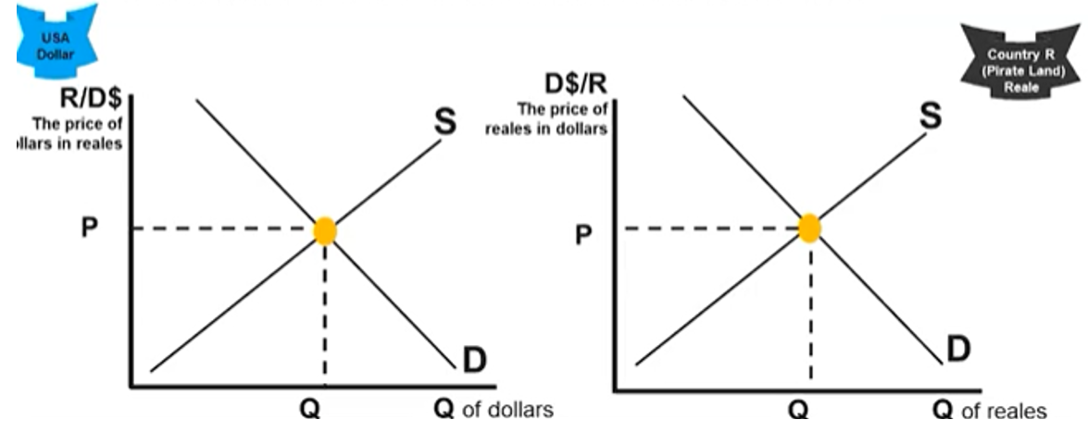
Relationship Between Two Currencies – Supply and Demand
We have covered the demand and supply of a single currency.
However we often need to consider how movements in one market affect another market.
The rule for this is as follows:
  ∆Demand of Currency A = ∆ Supply of Currency B
  ∆Demand of Currency B = ∆ Supply of Currency A
  The movement will also be in the same direction ie. ↑Demand of Currency A = ↑ Supply of Currency B
Summary
∆Demand of Currency A = ∆ Supply of Currency B
∆Demand of Currency B = ∆ Supply of Currency A
Movement will also be in the same direction ie. ↑Demand of Currency A = ↑ Supply of Currency B
↑Demand of Currency A = ↑ Supply of Currency B
In this case, there is more demand for Dollars.
This means that people are giving up more of their Reales to buy Dollars.

Slide 53
Relationship Between Two Currencies – Supply and Demand
In this case, if the Demand_{Dollars} decreases, this means that less people who have Reales are exchanging their Reales for dollars, therefore Supply_{Reales} is less
In this case, there is less demand for Dollars.
This means that people are giving up fewer Reales to buy Dollars.
↓Demand of Currency A = ↓ Supply of Currency B

Slide 54
Remember that when there are only a change in demand for a currency, there is always a change in supply of the other currency (in the same direction)!
  Why? Money going to one currency means money leaving another currency.
  Note: This applies especially in AP Macro Questions where the question is only dealing with two currencies.

Slide 55
What happens to supply of currency B when there is an increase in demand of currency A?
We assume there is an increase in supply of currency B.
  (People with currency B are giving them away to get more currency A.)

Slide 56
Suppose there is an increase in investment in Chinese stocks. What would happen to the supply and demand of RMB and AUD (Australian Dollars)?
↑Demand for RMB
↑Supply of AUD
People with Australian Dollars would be exchanging this for RMB in order to invest in Chinese stocks.

Slide 57
Relationship Between Two Currencies – Exchange Rates
We have looked at how Demand and Supply are related in multiple markets, therefore we can also examine the relationship between exchange rates.
The rule for this is as follows:
  ↑Exchange Rate of Currency A = ↓ Exchange Rate of Currency B
  ↓ Exchange Rate of Currency A = ↑ Exchange Rate of Currency B
Summary
∆Demand of Currency A = ∆ Supply of Currency B
∆Demand of Currency B = ∆ Supply of Currency A
↑Exchange Rate A = ↓Exchange Rate B
In this case, there is more demand for Dollars.
This means that people are giving up more of their Reales to buy Dollars.

Slide 58
Relationship Between Two Currencies – Exchange Rates
In this case, a depreciation in USD will lead to an appreciation in Reales.
↓Exchange Rate A = ↑Exchange Rate B

Slide 59
Conclusion: Value of Two Currencies
Remember: In a flexible exchange rate regime, exchange rates appreciate and depreciate due to changes in currency demand and supply.
Remember that when there is appreciation in one currency, there is always a deprecation in the other currency!
  Why? Money going to one currency means money leaving another currency.
  Note: This applies especially in AP Macro Questions where the question is only dealing with two currencies.

Slide 60
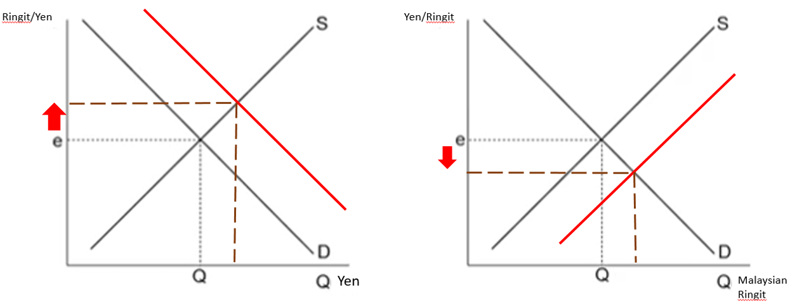
If there are only two currencies in the world, Japanese Yen and Malaysian Ringit, what happens if the Japanese Yen appreciates?
The Malaysian Ringit will depreciate.
This could be caused for example by an increase in demand for Japanese currency, which would mean an increase in supply for Malaysian Ringit.

Slide 61
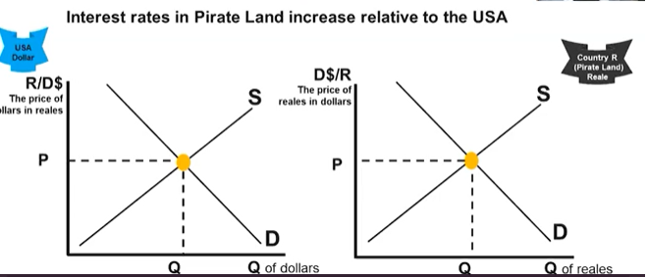
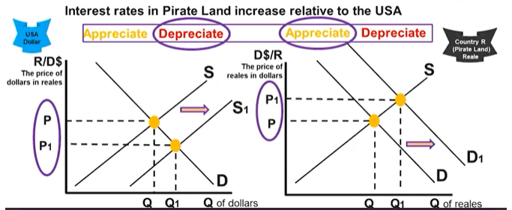
Note: Although we can say interest rates and inflation affect both D_{A} and S_{A}, in such a question with two currencies, drawing just the effect on D is sufficient.

Slide 62
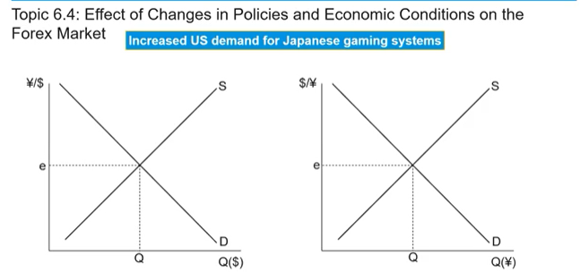
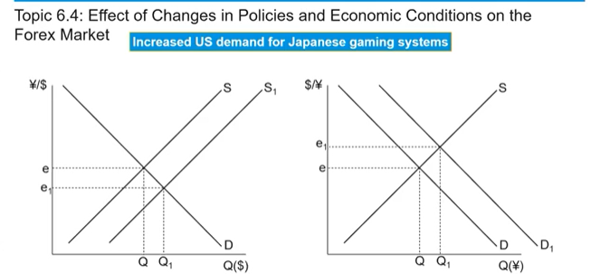
Example
Challenge: Draw both graphs and label the axes correctly.
Remember that the exchange rate is in terms of how much another currency buys of the currency in question.

Slide 63
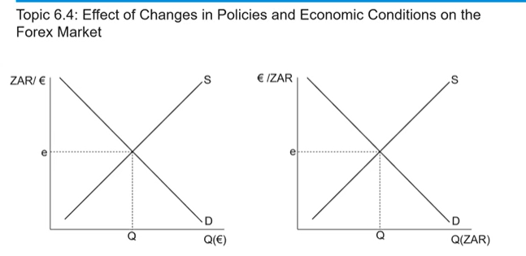
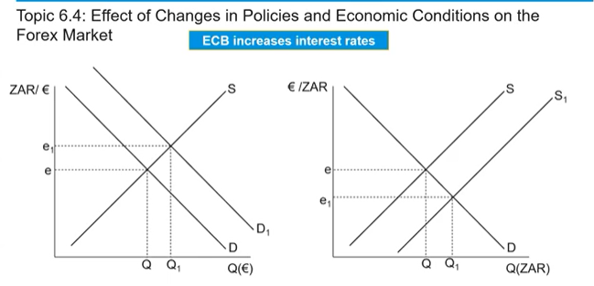
European Central Bank

Slide 64
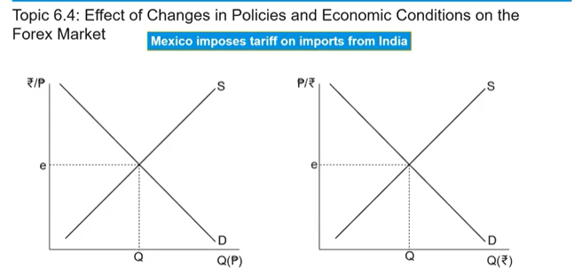
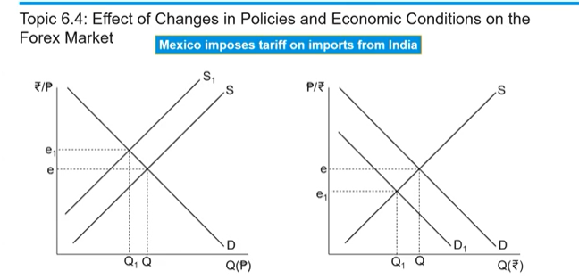

Slide 65
Foreign Exchange Market Summary
The Foreign Exchange Market (Forex market) is where currencies are exchanged and determines the exchange rate/price of currency.
Fixed Exchange rate = exchange rate is constant
Floating exchange rate = moves up and down via market forces
Appreciation
Change in Equilibrium: ↑Demand→↑Price↑Quantity
↓Demand→↓Price↓Quantity
↑Supply→↓Price↑Quantity
↓Supply→↑Price↓Quantity
∆Demand & ∆Supply = either Price or Quantity indeterminate
Depreciation = ↓Purchasing Power → ↓Imports ↑Exports
→Benefits for foreigners buying your currency
Appreciation = ↑Purchasing Power →↑Imports ↓Exports
→Benefits for those buying foreign currencies
Depreciation
Determinants of Demand AND Supply
Tastes and Preferences
Income Level
Interest Rates(affects D and S)
Price Level (Inflation) (affects D and S)
Trade Policies (eg. Taxes on imports)
Expectations of Future Exchange Rate
Surplus and shortage occurs when the price is too high or low.
↑Supply Currency A=↑Demand Currency B and vice versa.

Slide 66
Krugman Module Coverage
41, 42, 43, 44

